Slide 1
Presentation brief for MCT’s
Title of presentation | Working with Relational Data Stores in the Cloud.
Presentation\Lab length | Presentation: 40 - 45 minutes. Lab: 40 - 45 minutes.
Audience | Data Professionals, Data Architects, Business Intelligence Professionals, Developers.
Purpose | Provide a high level overview of the benefits, configuration and provisioning of SQL Database. Focus on the SQL Data Warehouse architecture, how it can be provisioned and how you can efficiently load data.
(think) Student key takeaways | The student should understand the difference between SQL Database and SQL Data Warehouse. The student should understand the concepts of Massively Parallel Processing.
(feel) Student desired mindset | The student should feel that they have a good understanding of SQL Database already. The student should feel that they have a clear understanding of when SQL Data Warehouse should be used.
(do) Student outcomes | The student should be able to provision a SQL Database. The student should be able to provision a SQL Data Warehouse. The student should be able to use PolyBase to load data into a SQL Data Warehouse.
More information | For MCT course feedback, visit the Microsoft Official Courseware forum

Slide 2

DP-200T01: Working with Relational Data Stores in the Cloud

Slide 3
Agenda
L01 - Work with Azure SQL Database
L02 - Work with SQL Data Warehouse
L03 - Provision and query data in Azure SQL Data Warehouse
L04 - Import data into Azure SQL Data Warehouse using PolyBase

Slide 4










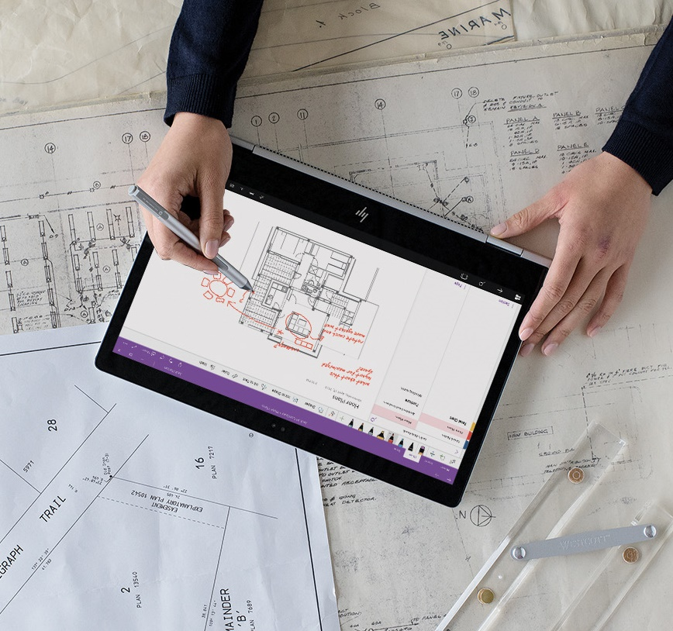


Lesson 01
Azure SQL Database
Data
Cloud
AI

Slide 5
Lesson Objectives
Why Azure SQL Database is a good choice for running your relational database
What configuration and pricing options are available for your Azure SQL database
How to create an Azure SQL database from the portal
How to use Azure Cloud Shell to connect to your Azure SQL database, add a table, and work with data

Slide 6

Why Azure SQL Database is a good choice
Convenience
Cost
Scale
Security

Slide 7
Azure SQL Database configuration options
When you create your first Azure SQL database, you also create an _Azure SQL logical server_. Think of a logical server as an administrative container for your databases.
DTUs
vCores
SQL elastic pools
SQL Managed Instances
DTU stands for Database Transaction Unit and is a combined measure of compute, storage, and IO resources. Think of the DTU model as a simple, preconfigured purchase option.
vCore gives you greater control over what compute and storage resources you create and pay for. vCore model enables you to configure resources independently.
SQL elastic pools relate to eDTUs. They enable you to buy a set of compute and storage resources that are shared among all the databases in the pool. Each database can use the resources they need.
The SQL managed instance creates a database with near 100% compatibility with the latest SQL Server on-premises Enterprise Edition database engine, useful for SQL Server customers who would like to migrate on-premises servers instance in a "lift and shift" manner.

Slide 8
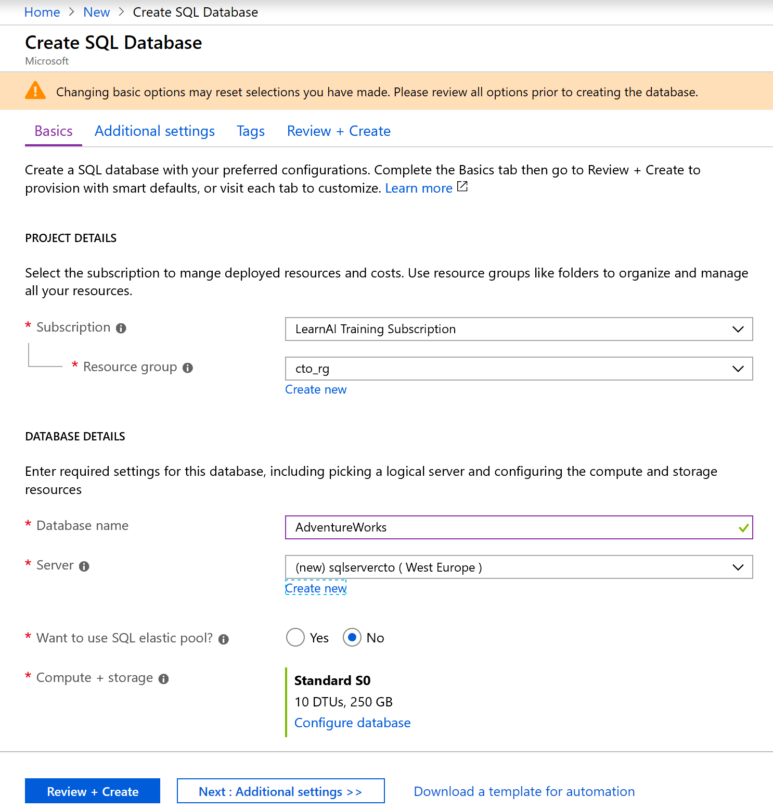
Create an Azure
SQL Database.

Slide 9
sqlcmd -S tcp:contoso-1.database.windows.net,1433 -d Logistics -U martina -P "password1234$" -N -l 30
Use Azure Cloud Shell to connect to your Azure SQL database
CREATE TABLE Drivers (DriverID int, LastName varchar(255), FirstName varchar(255), OriginCity varchar(255)); GO
SELECT name FROM sys.tables; GO
INSERT INTO Drivers (DriverID, LastName, FirstName, OriginCity) VALUES (123, 'Zirne', 'Laura', 'Springfield'); GO

Slide 10
Review Questions
Q01 – Who's responsible for performing software updates on your Azure SQL databases and the underlying OS?
A01 – Microsoft Azure. Azure manages the hardware, software updates, and OS patches for you.
Q02 - What is an Azure SQL logical server?
A02 - An administrative container for your databases.
Q03 - Your Azure SQL database provides adequate storage and compute power. But you find that you need additional IO throughput. Which performance model might you use?
A03 - vCore

Slide 11
Lesson 02
Azure SQL Dara Warehouse
Data
Cloud
AI

Slide 12
Lesson Objectives
List the types of data warehousing solutions
Explain Azure SQL Data Warehouse
Explain Massively Parallel Processing Concepts
Compare Table Geometries
Create an Azure SQL Data Warehouse

Slide 13
Types of Data Warehousing Solution
Bottom-Up Architecture
Designed by Dr. Ralph Kimball. This approach is based on the notion of "Connected Data Marts."
Best Practice.
Enterprise Data Warehouse
A centralized data store that provides analytics and decision support services across the whole enterprise.
Data Marts
A Data Mart is designed for the needs of a single team or business unit such as sales or human resources.
Operational Data Stores
An ODS is used as an interim store to integrate real-time data from multiple sources for additional operations on the data.
Top-down Architecture.
Designed by Dr. Bill Inmon. This approach is about creating one single integrated "Normalized Warehouse", which means the internal relational constructs follow the rules of normalization.
.

Slide 14




What is Azure SQL Data Warehouse
An elastic, relational data warehouse-as-a-service which if fully managed by Microsoft. Support your smallest to your largest data storage needs while handling queries up to 100x faster.
Elastic scale & performance
Market Leading Price & Performance
Powered by the Cloud
Get started in minutes
Integrated with Azure ML, PowerBI & ADF
Enterprise Ready
Simple billing compute & storage
Pay for what you need, when you need it with dynamic pause
Bring DW to the Cloud without rewriting
Scales to petabytes of data
Massively Parallel Processing
Instant-on compute scales in seconds
Query Relational / Non-Relational

Slide 15
Massively Parallel Processing (MPP) Concepts
Control Node
Compute Node
Compute Node
Compute Node
011010101010101010110101011101010101011011010010
011010101010101010110101011101010101011011010010
011010101010101010110101011101010101011011010010
011010101010101010110101011101010101011011010010
011010101010101010110101011101010101011011010010
011010101010101010110101011101010101011011010010
Compute Node
Compute Node
Compute Node
011010101010101010110101011101010101011011010010
011010101010101010110101011101010101011011010010
011010101010101010110101011101010101011011010010
011010101010101010110101011101010101011011010010
011010101010101010110101011101010101011011010010
Notes:
MPP is often a single master system (one control node) with multiple slaves (multiple compute node – upto 60 nodes)
Therefore only one Control Node
The compute node:
does most of the data processing work
Final Computation can happen on Control node but not always
Holds the data

Slide 16
MPP SQL Table Geometries
Distributed:
A table structure that is distributed across all MPP nodes of the Data Warehouse Database
HASH: where the value of a single column gets hashed to define the distribution number where the records will get inserted
ROUND_ROBIN: where the records are distributed in a “round robin” manner across all distributions
REPLICATED: Where a copy of an entire table is placed on each compute node.
Notes:
Distributed tables
- Each distribution is a separate physical table in the DBMS
- Related to but different from partitioned tables
Replicated tables are not supported in Azure SQL Data Warehouse
Temporary table
- A table used to distribute data to multiple locations for query optimizations and aggregations
https://azure.microsoft.com/en-us/documentation/articles/sql-data-warehouse-tables-distribute/

Slide 17
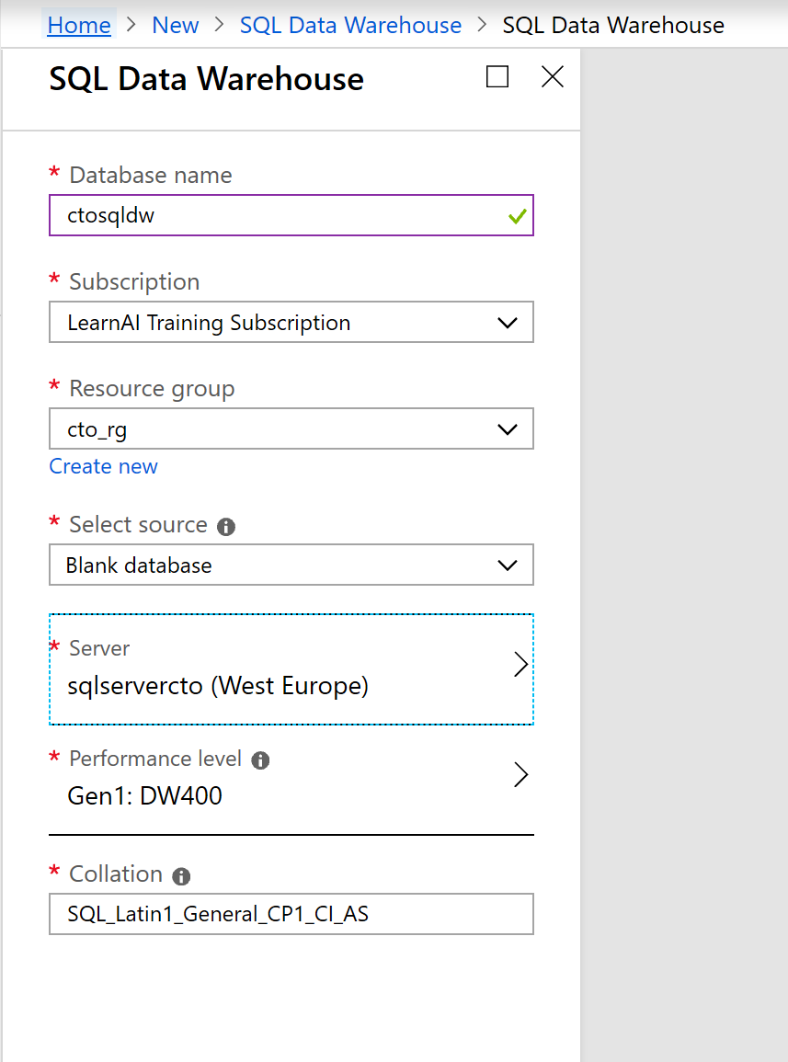
Create an Azure SQL
Data Warehouse

Slide 18
Review Questions
Q01 - Which of the following terms refer to the scale of compute that is being used in an Azure SQL Data Warehouse database?
A01 – DWU
Q02 - You have an Azure SQL Data Warehouse database, within this, you have a dimension table named Stores that contains store information. There is a total of 263 stores nationwide. Store information is retrieved in more than half of the queries that are issued against this database. These queries include staff information per store, sales information per store and finance information. You want to improve the query performance of these queries by configuring the table geometry of the stores table. Which is the appropriate table geometry to select for the stores table?
A02 – Replicated Table

Slide 19
Lesson 03
Creating and Querying an
Azure SQL Data Warehouse
Data
Cloud
AI

Slide 20
Lesson Objectives
Create an Azure SQL Data Warehouse sample database
Query the sample database with the SELECT statement and its clauses
Use the queries in different client applications such as SQL Server Management Studio, and PowerBI

Slide 21
Create an Azure SQL
Data Warehouse

Slide 22
SELECT Query Basics
SELECT <select_list>
[FROM <optional_from_specification>]
[WHERE <optional_filter_condition>]
[ORDER BY <optional_sort_specification>]
[JOIN <optional_join_specification>]
Perform
Azure SQL Data Warehouse
Queries.
Examples
SELECT *
FROM Products p WHERE p.id ="1“
SELECT p.id, p.manufacturer, p.description
FROM Products p WHERE p.id ="1“
SELECT p.price, p.description, p.productId
FROM Products p ORDER BY p.price ASC
SELECT p.productId
FROM Products p JOIN p.shipping

Slide 23
Create Table as Select (CTAS)
Used in parallel data loads
CREATE TABLE
[ database_name . [ schema_name ] . | schema_name. ] table_name
[ ( { column_name } [ ,...n ] ) ]
WITH ( DISTRIBUTION =
{ HASH( distribution_column_name ) REPLICATE | ROUND_ROBIN }
[ , <CTAS_table_option> [ ,...n ] ]
)
AS <select_statement> [;]
Perform
Azure SQL Data Warehouse
Queries.
Example
CREATE TABLE FactInternetSales_Copy
WITH
(DISTRIBUTION = HASH(SalesOrderNumber))
AS SELECT * FROM FactInternetSales

Slide 24
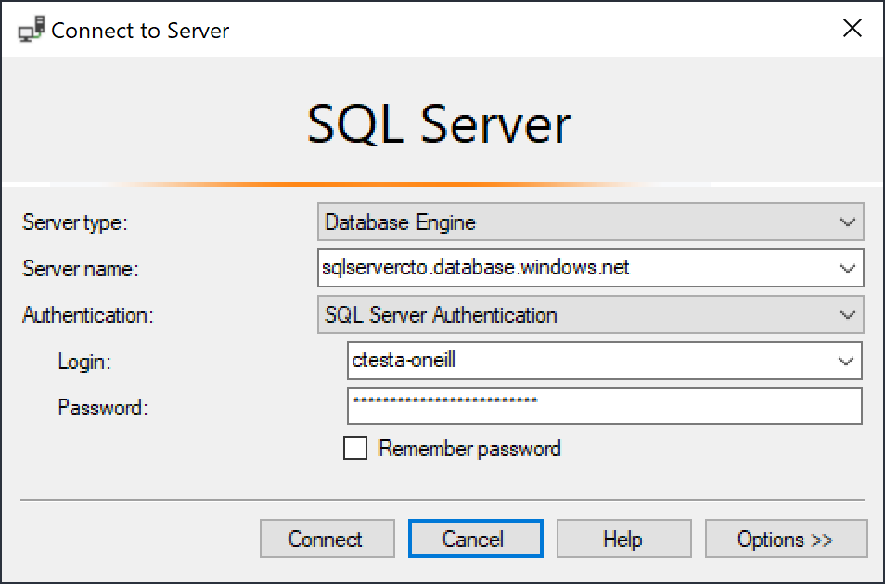
Querying with different
client applications.

Slide 25
Review Questions
Q01 – What is the default port for connecting to an Azure SQL Server Data Warehouse?
A01 – TCP port 1433
Q02 - The following query is to retrieve the sales by business reseller, but the performance of the query is slow. The query is as follows:
SELECT
S.[SalesAmount] AS [Sales],
R.[BusinessType],
R.[ResellerName]
FROM [FactResellerSales] AS S
JOIN [DimReseller] AS R
ON S.[ResellerKey] = R.[ResellerKey].
The tables referenced within the query are configured with a distribution of Round_Robin with a clustered columnstore index. The Data Engineer wants to improve the performance of the query. What operation can be used to improve the performance of the query?
A02 – Change the Distribution to HASH(ResellerKey) for both tables.

Slide 26
Lesson 04
Using PolyBase to Load Data
in Azure SQL Data Warehouse
Data
Cloud
AI

Slide 27
Lesson Objectives
Explore how PolyBase works
Upload text data to Azure Blob store
Collect the security keys for Azure Blob store
Create an Azure SQL Data Warehouse
Import data from Blob Storage to the Data Warehouse

Slide 28

How PolyBase works
Hadoop cluster
The MPP engine’s integration method with PolyBase
MPP DWH Engine
Compute Node
Compute Node
Control Node
DMS
DMS
Azure Blob/Data Lake
Name Node
Data Node
Data Node
Data Node
Data Node
Data Node
Data Node
Data Node
Data Node

Slide 29
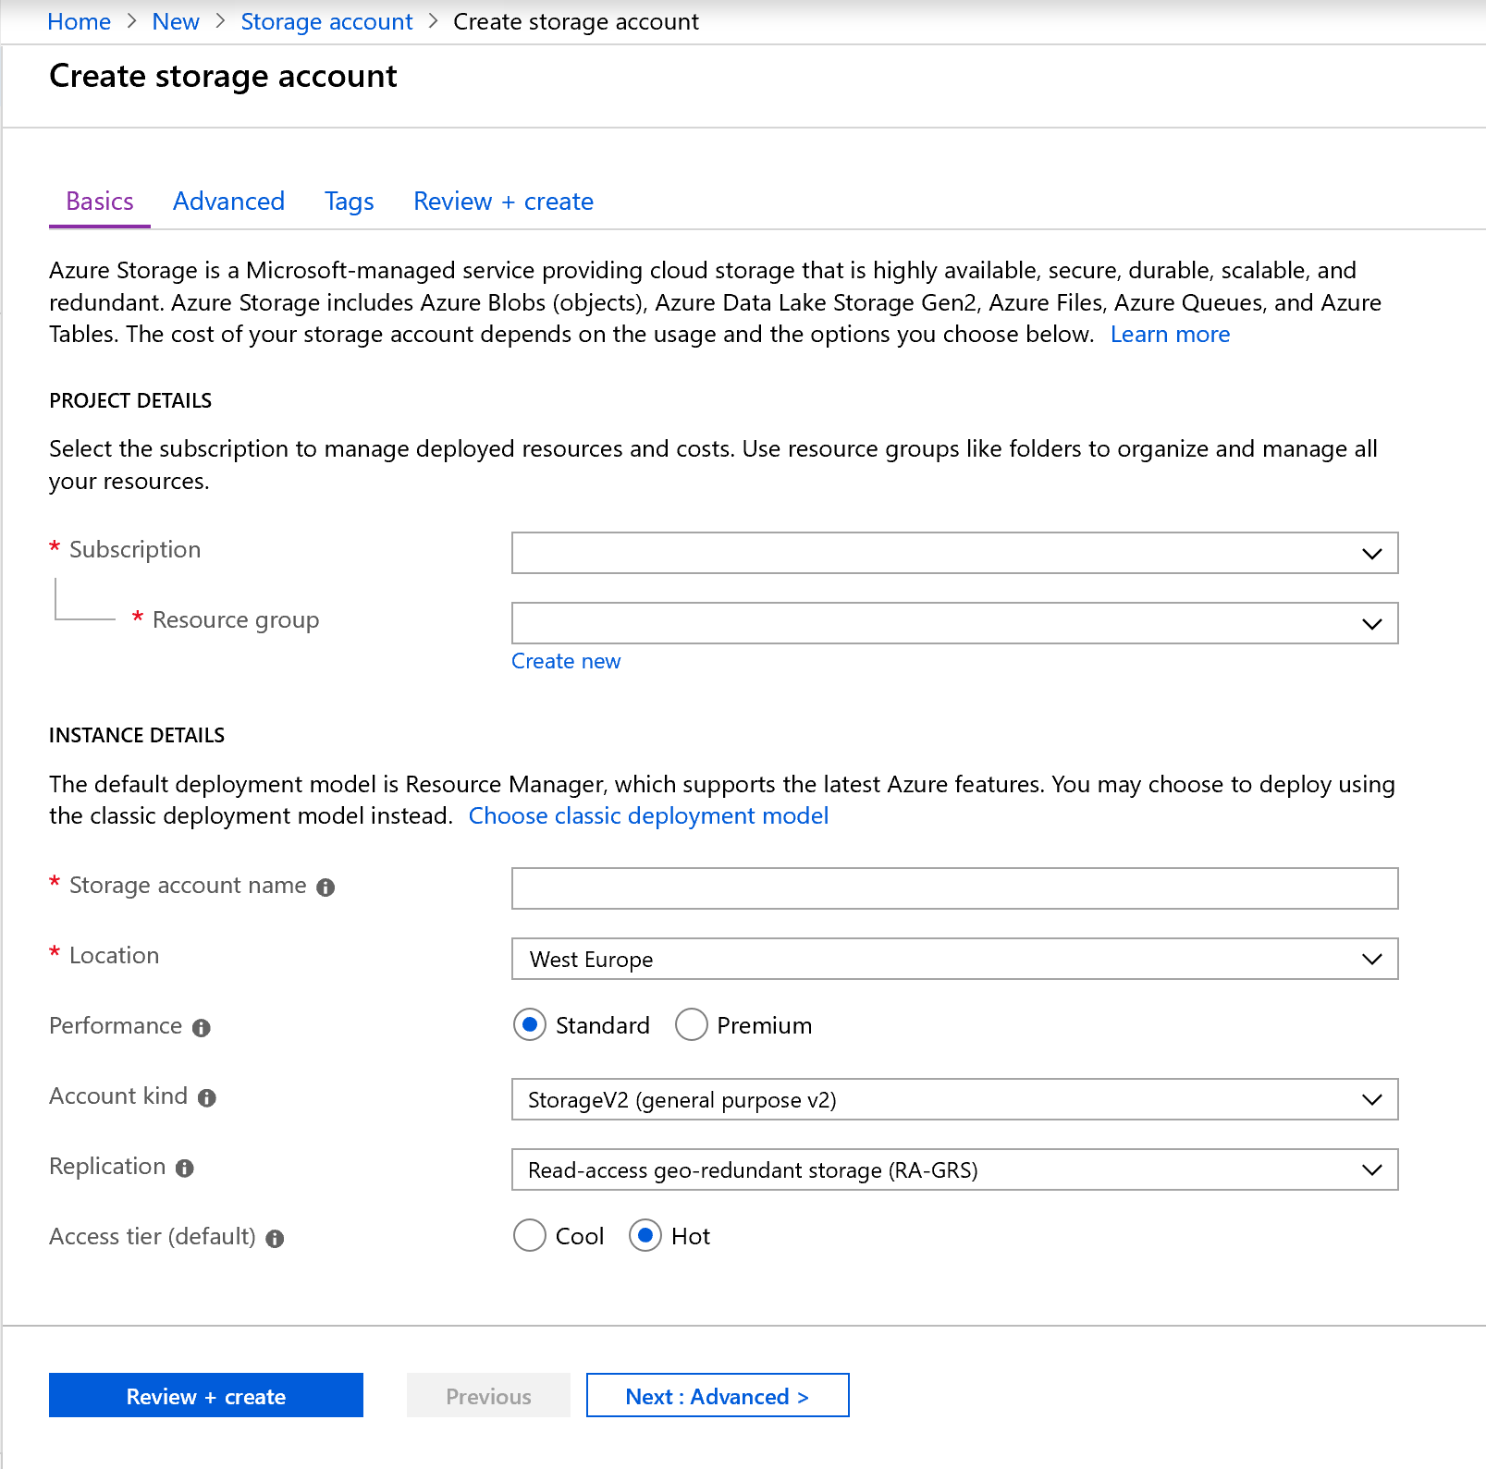
Upload text data to Azure Blob store

Slide 30
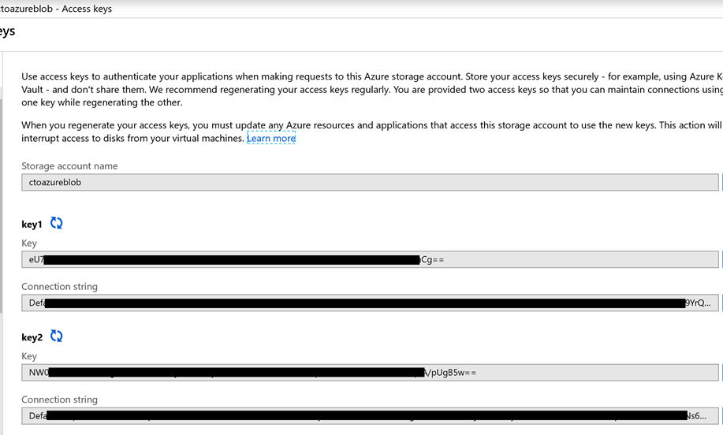
Collect the Storage keys

Slide 31
Create an Azure SQL
Data Warehouse

Slide 32
Import data from Blob Store to SQL DW
--STEP 1: Create an external data source for Hadoop
-- DROP EXTERNAL DATA SOURCE FXR_TEST_DSRC;
CREATE EXTERNAL DATA SOURCE FXR_TEST_DSRC
WITH ( TYPE = HADOOP
, LOCATION = 'hdfs://192.168.210.145:8020'
, JOB_TRACKER_LOCATION = '192.168.210.145:8032‘
---- defaults: 8021 – Cloudera 4.3; 8032 – HDP 2.x on Windows | Cloudera 5.1;
---- 8050 – HDP 2.x on Linux; 50300 – HDP 1.3
);
--STEP 2: Create an external file format for a Hadoop text-delimited file.
--DROP EXTERNAL FILE FORMAT FXR_Test_Format;
CREATE EXTERNAL FILE FORMAT FXR_Test_Format
WITH ( FORMAT_TYPE = DELIMITEDTEXT
, FORMAT_OPTIONS ( FIELD_TERMINATOR = N';‘
, USE_TYPE_DEFAULT = TRUE
, STRING_DELIMITER = '')
);
Notes:
HDInsight is the same as HDP
HDP =“ Hortonworks HDP”

Slide 33
Import data from Blob Store to SQL DW
--STEP 3: Create a new external table in SQL Server MPP SQL
-- DROP EXTERNAL TABLE Test;
CREATE EXTERNAL TABLE Test
(name nvarchar(17), startzeitpunkt nvarchar(35),
endzeitpunkt varchar(35), flms_system_realtime nvarchar(19), dummy nvarchar(19) NULL, Counter1DTonDur nvarchar(19), Counter1DMileage nvarchar(19), dummy2 nvarchar(2) NULL
)
WITH
(LOCATION = '/user/fxr47511/pdwtest'
, DATA_SOURCE = FXR_TEST_DSRC
, FILE_FORMAT = FXR_Test_Format
, REJECT_TYPE = value
, REJECT_VALUE = 1000
);

Slide 34
Import data from Blob Store to SQL DW
--STEP 4: Create a new external table in SQL Server MPP SQL
CREATE EXTERNAL TABLE dbo.Test_2
WITH ( LOCATION = '/user/fxr47511/pdwtest'
, DATA_SOURCE = FXR_TEST_DSRC
, FILE_FORMAT = FXR_Test_Format
, REJECT_TYPE = value
, REJECT_VALUE = 1000
)
AS
SELECT T1.* FROM dbo.FactInternetSales T1
JOIN dbo.DimCustomer T2 ON ( T1.CustomerKey = T2.CustomerKey )
Notes:
https://azure.microsoft.com/en-us/documentation/articles/sql-data-warehouse-load-polybase-guide/

Slide 35
Review Questions
Q01 – Mike is the data engineer for Contoso and has a Data Warehouse created with a database named Crystal. Within the database is a table named DimSuppliers. The suppliers' information is stored in a single text file named Suppliers.txt and is 1200MB in size. It is currently stored in a container with an Azure Blob store. Your Azure SQL Data warehouse is configured as Gen 2 DW30000c. How can Mike maximize the performance of the data load?
A01 – Split the text file into 60 files of 20MB each.
Q02 – Mike is the data engineer for Contoso and has a Data Warehouse created with a database name Crystal. He has created a master key, followed by a database scoped credential. What should he create next?
A02 – Strong

Slide 36

Lab: Working with Relational Data Stores in the Cloud

Slide 37
Lab overview
The students will be able to provision an Azure SQL Database and Azure SQL Data Warehouse and be able to issue queries against one of the instances that are created. They will be also be able to integrate SQL Data Warehouse with a number of other Data platform technologies and use PolyBase to load data from one data source into Azure SQL Data Warehouse.
Lab objectives
After completing this lab, you will be able to:
Use Azure SQL Database
Describe Azure Data Warehouse
Creating and Querying an Azure SQL Data Warehouse
Using PolyBase to Load Data into Azure SQL Data Warehouse

Slide 38
Lab scenario
You are the senior data engineer at AdventureWorks, and you are working with your team to transition relational database systems from on-premises SQL Servers to relational database located in Azure. You will begin by creating an instance of SQL Database that will be handed of the junior data engineers to migrate some departmental databases.
You will then provision a SQL Data Warehouse and test that the provisioning of the server is successful by testing a sample database with a series of queries. You will then use PolyBase to load dimension tables from Azure Blob and Azure Databricks to test that the integration of these data platform technologies with Azure SQL Data Warehouse.
At the end of this lad, you will have:
Use Azure SQL Database
Describe Azure Data Warehouse
Creating and Querying an Azure SQL Data Warehouse
Using PolyBase to Load Data into Azure SQL Data Warehouse

Slide 39
Lab review
Exercise 1 – Can you think how Azure SQL Database can help your organization?
Exercise 2 – Are there any students in the classroom who would consider SQL Data Warehouse a replacement for an existing solution?
Exercise 3 – Can you describe the table options that are available in Azure SQL Data Warehouse?
Exercise 4 – Why is it best practice to use PolyBase to load data into Azure SQL Data Warehouse?

Slide 40

Next steps
Module Summary
In this module, you have learned about:
- Work with Azure SQL Database.
- Work with SQL Data Warehouse.
- Provision and query data in Azure SQL Data Warehouse.
- Import data into Azure SQL Data Warehouse using PolyBase.
After the course, consider watching a video that explores a wide range of loading options in a video as a recap.

